Slide 1

DEPARTMENT OF ELECTRICAL & ELECTRONICS ENGINEERING SCHOOL OF ELECTRICAL & COMMUNICATION 10214EE601- MINOR PROJECT-I WINTER SEMESTER(2023-2024)
FINAL REVIEW
“FLOATING SOLAR PANEL WITH SUN POSITION TRACKING ”
Guided by Dr. KARUNANITHI.K
Professor / EEE
Presented by:
1. S.ADESH VTU 19723 2. ABHISHEK KUMAR VTU 19765
3.K.GUHAN VTU20248

Slide 2
OUTLINE
Abstract
Objectives
Solution Methodology
Block diagram
Circuit Diagram
List of Components
Result and Discussion
Conclusion
List of Reference

Slide 3
ABSTRACT
The demand for renewable energy sources has led to the exploration of innovative technologies to harness solar power more efficiently.
Floating solar photovoltaic (PV) systems have emerged as a promising solution, utilizing water bodies to host solar panels. This paper presents a floating solar panel system integrated with sun position tracking to maximize energy generation.
The system utilizes advanced sensors and algorithms to accurately determine the sun’s position relative to the floating solar panel array. By continuously adjusting the orientation of the panels, the system ensures that they are aligned perpendicular to the incoming sunlight, maximizing the energy output.
The sun position tracking algorithm is designed to consider various factors such as time of day, geographical location, and seasonal variations, ensuring optimal alignment under diverse conditions.
To implement the system, a floating platform is designed to withstand harsh environmental conditions, including wind, waves, and varying water levels. The solar panelsare securely mounted on the floating platform, and the tracking mechanisms are integrated intothe structure to maintain stability and reliability.
KEYWORD-: Solar Photovoltaic, Sun position tracking,Floating solar pannel,Tracking
mechanisms,Floating platform

Slide 4
OBJECTIVES
Efficient Solar Panel Placement: Develop a robust and adaptable floating platform that can accommodate a significant number of solar panels while ensuring maximum exposure to sunlight throughout the day. The design should consider factors such as panel spacing, tilt angles, and interconnection layout to optimize energy capture.
Sun Position Tracking Algorithm: Create an accurate sun position tracking algorithm that continuously calculates the sun's azimuth and elevation angles based on geographical location, date, and time. This algorithm will enable the solar panels to adjust their orientation dynamically, following the sun's movement in the sky for improved energy yield.
Energy Storage and Distribution: Design an efficient energy storage and distribution system to store surplus energy generated during peak sunlight hours and distribute it during periods of low sunlight or high demand. Battery storage technology and smart grid integration should be considered to enhance system reliability.

Slide 5
SOLUTION METHODOLOGY
1. Firstly the LDR sensor will detect the sun rays and the data is send to the aurdino.
2.The aurdino send the response to the servo motor and rotates the solar
pannel at particular angel.
3.And the PV pannel will collect the sunlight and convert into the elecrtic
current.
4.The electric current is send to the load (electrical appliances).
5. The excess energy is stored in the battery.

Slide 6
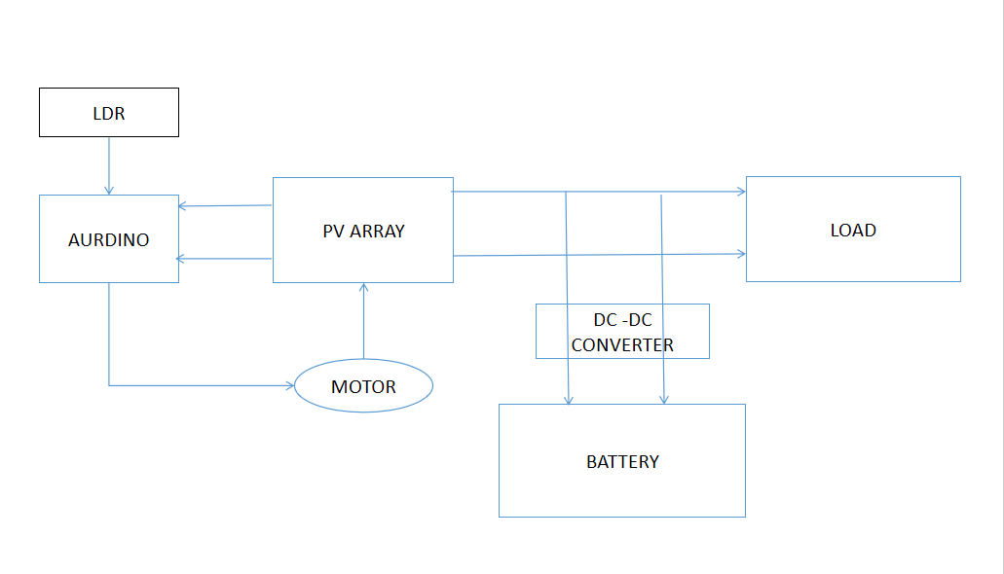
BLOCK DIAGRAM(Automatic Solar Tracking System)

Slide 7
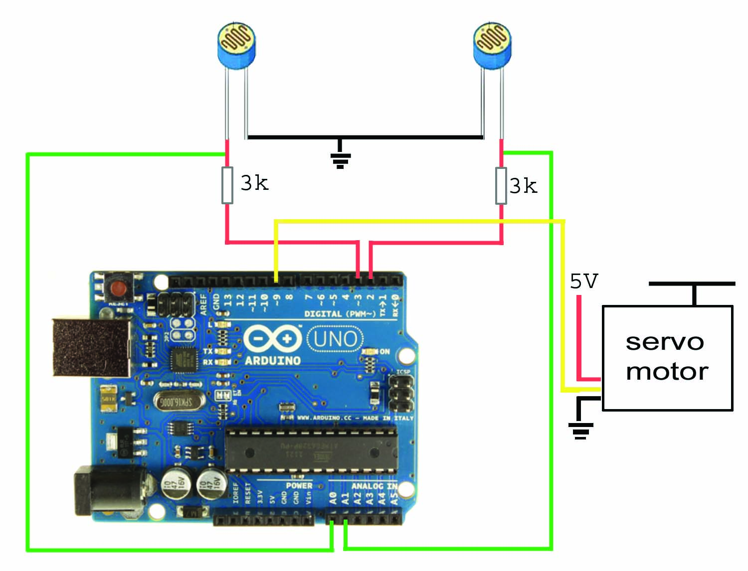
AURDINO BASED CIRCUIT DIAGRAM

Slide 8
LIST OF COMPONENTS
1. Solar Panel (12V, 20W)
2. LDR sensors
3. Arduino UNO
4. Bread board
5. Servo motor(MG995)
6. Resistors
7. Jumper wires
8. Battery(12V)
9. Converter(DC-DC Boost converter )

Slide 9
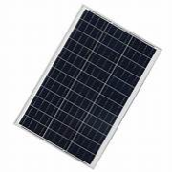
LIST OF COMPONENTS
1.Solar Panel-:A Solar panels (also known as ”PV panels”) is a device that converts lightfrom the sun, which is composed of particles of energy called ”photons”, into
electricity that can be used to power electrical loads
Specification-:
20watt
12v
0.6mA

Slide 10
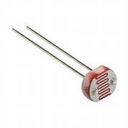
LIST OF COMPONENTS
LDR sensors-:A Light Dependent Resistor (LDR), also known as a photoresistor or pho_x0002_tocell, is a type of electronic component that exhibits a change in its electrical resistance in response to changes in the intensity of light striking its surface. In simpler terms, it is a sensor that can detect and measure light levels

Slide 11
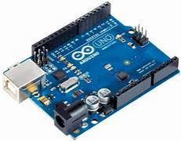
LIST OF COMPONENTS
ARDINO UNO-: The Arduino Uno is an open-touch code hardware development board commonly used in electronics and programming projects designed by Arduino LLC and is based on Atmel's ATmega328P microcontroller. The Arduino Uno is a versatile, easy-to-use board that propor_x0002_ciona an accessible development environment for people with little experience in electronics and programming.

Slide 12
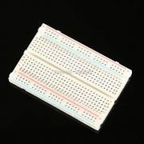
LIST OF COMPONENTS
BREAD BOARD-: A Breadboard, solderless breadboard, or protoboard is a construction base used to build semi-permanent prototypes of electronic circuits. Unlike a perf_x0002_board or stripboard, breadboards do not require soldering or destruction of tracks and are hence reusable.

Slide 13
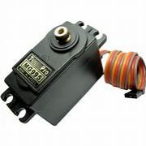
LIST OF COMPONENTS
Servo motor-:The unit comes complete with 30cm wire and 3 pin ’S’ type female header connector that fits most receivers, including Futaba, JR, GWS, Cirrus, Blue 14 Bird, Blue Arrow, Corona, Berg, Spektrum and Hitec. This high-speed stan_x0002_dard servo can rotate approximately 120 degrees (60 in each direction).

Slide 14
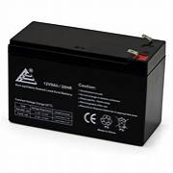
LIST OF COMPONENTS
12V BATTERY-: . The 12Vbattery is one of such common batteries. However, what do you know aboutthe 12-volt battery and what is its use? A 12-volt battery is a kind of battery that is often used for various electrical gadgets and appliances.

Slide 15
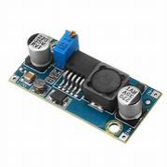
LIST OF COMPONENTS
Boost Converter-:Power for the boost converter can come from any suitable DC source, such as batteries, solar panels, rectifiers, and DC generators. A process that changes one DC voltage to a different DC voltage is called DC to DC conversion. A boost converter is a DC to DC converter with an output voltage greater than the source voltage.

Slide 16
RESULTS AND DISCUSSION
TIMES (Hrs) | PV ARRAY OUTPUT(V) | ANGEL(Degree)
06:00 | 08.25 | 3.83
07:00 | 9.52 | 3.83
08:00 | 09.89 | 5.36
09:00 | 10.33 | 7.9
10:00 | 10.76 | 12.43
11:00 | 10.82 | 20.06
12:00 | 11.00 | 27.93
13:00 | 10.82 | 26.45
14:00 | 10.56 | 17.85
15:00 | 10.32 | 11.05
16:00 | 10.08 | 7.09
17:00 | 09.26 | 4.89
18:00 | 08.34 | 4.84
The results for the project were gotten from LDRs for the solar tracking system and the panel that has a fixed position. The results were recorded for four days, recorded and tabulated. The outputs of the LDRs were dependent on the light intensity falling on their surfaces. Arduino has a serial that communicates on digital pins 0 and 1 as well as with the computer through a USB. If these functions are thus used, pins 0 and 1 can be used for digital input or output. Arduino environment’s built in serial monitor can be used to com_x0002_municate with the To collect the results,code was written that made it possible to collect data from the LDRs after every one hour. In this we assume the angel at 0 degree and the tabel shown for ever 1hr angel change between them.

Slide 17
CONCLUSION
Energy is the primary foundation upon which the entire society is founded in today's world of unbridled output. As it is said that energy cannot be generated or destroyed, this might be interpreted to mean that it can be stored in some way. This effort has attempted to untangle the road of such objectivity in order to make such a purpose substantiated. It is very normal that continual usage of energies leads to shortage in terms of earthly resources. Sun spiked above the tallest source in the stand For age, starting from the beginning of the cosmos, through which life was conceived, is the fundamental and mother source of all energy. The proposal has been unravelled by considering the basic principles of storing such energy. Other than from the Sun, energies have been created by the burning of various materials, resulting in the production of a vast quantity of pollutants, leading the environment and the atmosphere to deteriorate day by day. Every day is a fresh task of hatching something new and distinct, which causes an energy to be the fundamental source of all the hard work that exists. In this light, it would be more appropriate to expose that commercialization has spread its wings to such a degree in desire of moneyand power that we are now in a pool of severe ignorance of the world's resources. Scarcity, as a result of which the entire globe suffers.

Slide 18
REFERENCE
A Review” by Jaya N. Suptile and Tejaswini M. Joshi: This review article discusses the application of floating solar panels and may include informa_x0002_tion on sun tracking..
A Review” by Vikram Kapoor and G. N. Tiwari: This paper may offerinsights into innovative technologies related to floating solar panels and tracking.
A Review” by Sai Fai Hui; H.F. Ho; W.W. Chan; K.W. Chan; W.C. Lo; K. W. E. Cheng: This paper Floating solar cell power generation, powerflow design and its connection and distribution.
A Review” by Shi Xuewei; Shi Xuefang; Dong Wenqi; Zang Peng; Jia Hongyan; Wu Jinfang; Wang Yang:This paper Research on Energy Storage Configuration Method Based on Wind and Solar Volatility.
A Review” by Anupam Sharma; Madhu Sharma:This paper Power and energy optimization in solar photovoltaic and concentrated solar power systems.

Slide 19
REFERENCE
A Review” by Trinabh Gautam and B.M. Shafiul Alam: This paper pro_x0002_vides an overview of floating solar photovoltaic systems and discusses their advantages and challenges.
A Review” by B.C. Prasanna and S. Nagaraja: This review article dis_x0002_cusses various solar tracking systems, including those used for floating so_x0002_lar panels. Review ” by Manel Kharrat, et al.: This paper explores the optimization of floating solar PV systems, including tracking systems.
A Review” by Akhil Sivadas and M. Jaya Bharata Reddy: This reviewarticle examines the performance of floating solar PV systems, considering factors like tracking
A Review” by Muhammad Murtadha Othman, et al.: This paper focuses on the design and development of a floating solar tracker system
A Review” by Soteris A. Kalogirou: This book covers various aspects ofsolar energy systems, including solar tracking systems.

Slide 20
REFERENCE
A Review” by Naftalin Winanti; CHA Andre Mailoa; Handoko Rusiana Iskandar, Giri Angga Setia; Nivika Tiffany Somantr :This paper SystemOptimization Design Of Rooftop Grid-Tied Solar Power Plant For Resi-dential Customers In Indonesia.
A Review” by H. J. Hou, Y. P. Yang: Y. H. Cui; S. Gao; Y. X. Pan :This paper Assessment of concentrating solar power prospect in China.
A Review” by Gao Song: Hou Hongjuan; Yang Yongping :This paper Optimize on the temperature of solar collectors in solar aided coal-fired electric generation.
A Review” by Nikolay Mestnikov: Ahmad Alzakkar; Yuri Samofalov :This paper The Impact of Introducing Solar Radiation Concentration System for Solar Power Plants Under Conditions of the Russian Far North.
A Review” by Surendra Singh; Avdhesh Sharma; Akhil Ranjan Garg; Om Prakash Mahela :This paper Spotting the Power Quality Events Associated to Utility Distribution Power Network with Solar Energy Power Genera_x0002_tion.

Slide 21
THANK YOU

